Slide 1



NumPExx
Kickoff ExaDost, Paris 2023.09.13
Scaling up Scikit-Learn for Exascale
Exascale computing
ExaDosT Kick-off meeting

Slide 2
NumPExx
Exascale computing
Scikit-learn:
The reference library for ML on tabular data
Many reference algorithms (no deep learning)
Tools designed to create ML Pipelines (preprocessing)
Utilities to perform hyperparameter optimization
Tools to evaluate the results
ExaDosT Kick-off meeting

Slide 3



NumPExx
Exascale computing
Scikit-learn:
The reference library for ML on tabular data
Current contraints
Input are pandas or numpy arrays
Parallelism is done using joblib
No GPU acceleration (for now)
ExaDosT Kick-off meeting

Slide 4
NumPExx
Exascale computing
A zoom in the future development of Scikit-Learn
I - Parallelism in scikit-learn
II – The Array API
III - Exploring a plugin system in scikit-learn
ExaDosT Kick-off meeting

Slide 5






NumPExx
Exascale computing
A high level API with joblib:
?
> Embarassingly Parallel tasks, with pluggable backends
ExaDosT Kick-off meeting

Slide 6

NumPExx
Exascale computing
Low-level parallelism:
Calls to BLAS (through numpy) are parallelised
Low level parallelism using openMP
> Intrinsic parallelism, dependent on the data structure and the algorithm.
Challenge: sometime hard to make the different parallelism levels cohexist!
ExaDosT Kick-off meeting

Slide 7
NumPExx
Exascale computing
A zoom in the future development of Scikit-Learn
I - Parallelism in scikit-learn
II – The Array API
III - Exploring a plugin system in scikit-learn
ExaDosT Kick-off meeting

Slide 8
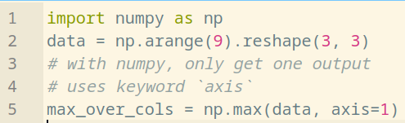
NumPExx
Exascale computing
Introduction to the array API standard:
ExaDosT Kick-off meeting

Slide 9
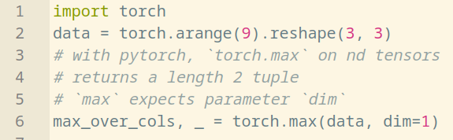
NumPExx
Exascale computing
Introduction to the array API standard:
ExaDosT Kick-off meeting

Slide 10
NumPExx
Exascale computing
Introduction to the array API standard:
Different array libraries can have different syntax for the same operation !
ExaDosT Kick-off meeting

Slide 11
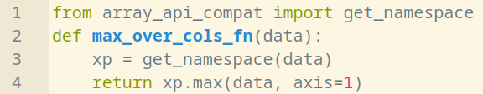
NumPExx
Exascale computing
Introduction to the array API standard:
The Array API enables writing agnostic single-source code and interface it with all arrays !
ExaDosT Kick-off meeting

Slide 12


NumPExx
Exascale computing
Introduction to the array API standard:
The Array API enables writing agnostic single-source code and interface it with all arrays !
ExaDosT Kick-off meeting

Slide 13
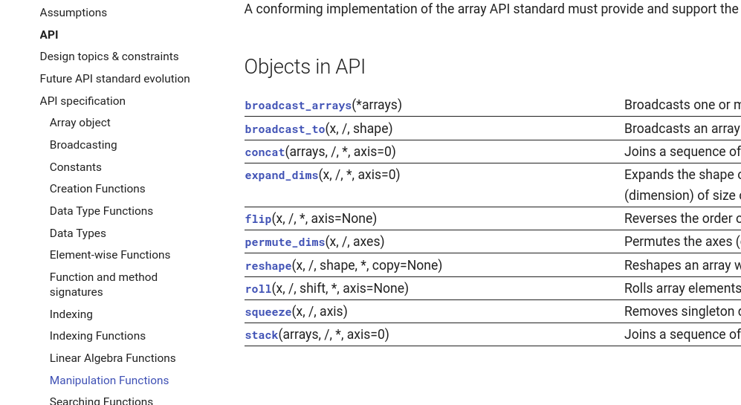
NumPExx
Exascale computing
Array API spec excerpt:
https://data-apis.org/array-api/latest/API_specification/index.html
ExaDosT Kick-off meeting

Slide 14




NumPExx
Exascale computing
Compatible array libraries:
(done or ongoing)
(non-exhaustive)
CPU
CPU
GPU AMD/INTEL/NVIDIA
OTHERS
CPU
DISTRIBUTED
Dpctl + DPNP
CPU
GPU INTEL
GPU NVIDIA
ExaDosT Kick-off meeting

Slide 15
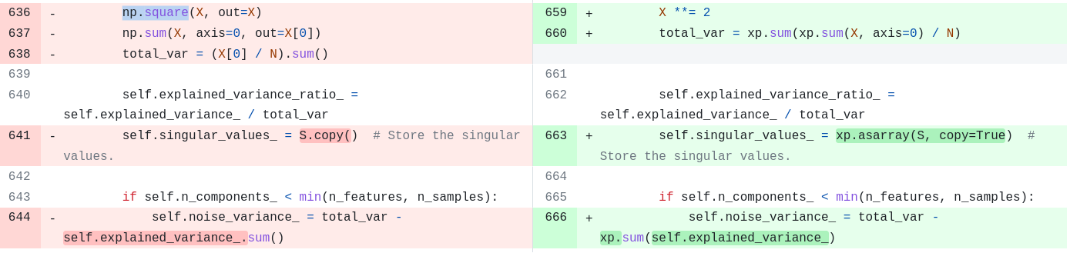

NumPExx
Exascale computing
Toward Array API compliancy in scikit-learn:
When possible, use the Array Api rather than numpy calls !
Excerpt of https://github.com/scikit-learn/scikit-learn/pull/26315
ENH Array API support for PCA
ExaDosT Kick-off meeting

Slide 16



NumPExx
Exascale computing
Towards Array API compliancy in scikit-learn:
sklearn.lda.LDA
sklearn.decomposition.PCA
(next release)
sklearn.preprocessing.MinMaxScaler (ongoing)
Discussions and roadmaps #22352 #26024 #26083
ExaDosT Kick-off meeting

Slide 17

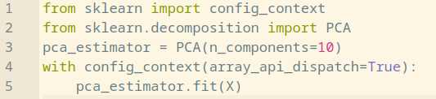

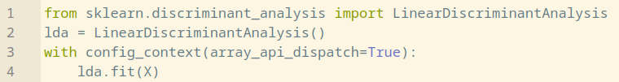
NumPExx
Exascale computing
Towards Array API compliancy in scikit-learn:
How to use it ?
Experimental features require explicit
activation in scikit-learn config class
ExaDosT Kick-off meeting

Slide 18
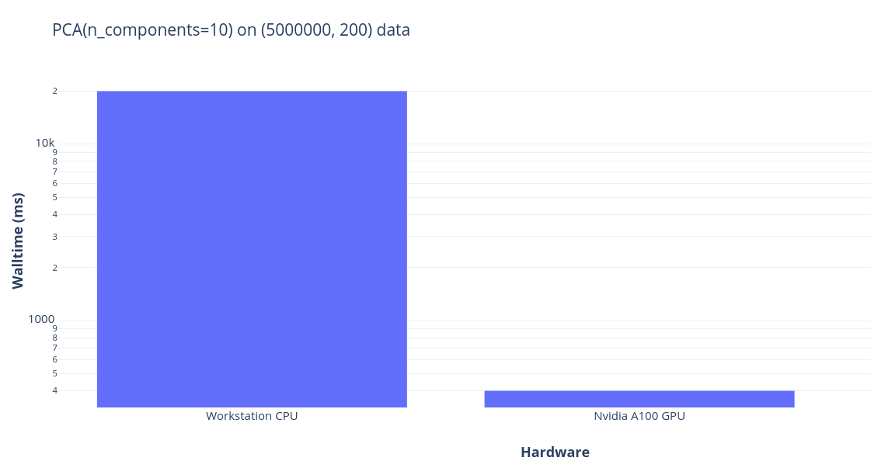
NumPExx
Exascale computing
Towards Array API compliancy in scikit-learn:
What about performance ?
YES when CPU takes too long
40x speedup with pytorch on GPU
NB: pytorch backend for intel GPUs currently lacks optimization for QR factorization, so Intel GPUs are not included in the figure
ExaDosT Kick-off meeting

Slide 19

NumPExx
Exascale computing
Towards Array API compliancy in scikit-learn:
Will all estimators support all compatible array libraries ?
Likely not :-(
Current limitations of the Array API approach:
    Does not cover all functions for all libraries (torch.topk, np.argpartition, RNG…)
    Lacks synchronization functions for libraries that evaluate lazily (dask, jax...)
    Not all algorithms can be implemented (efficiently) with high level array operations !
        (random forest, histogram gradient boosting trees,…)
ExaDosT Kick-off meeting

Slide 20
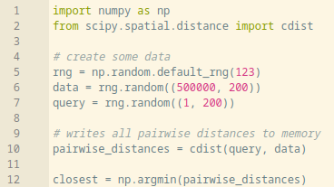
NumPExx
Exascale computing
Possible drawbacks for the Array API:
Each call to a high-level array function writes the result into memory.
Example of pairwise_distance + argmin common pattern:
ExaDosT Kick-off meeting

Slide 21
NumPExx
Exascale computing
A zoom in the future development of Scikit-Learn
I - Parallelism in scikit-learn
II – The Array API
III - Exploring a plugin system in scikit-learn
ExaDosT Kick-off meeting

Slide 22
NumPExx
Exascale computing
Exploring a plugin system in scikit-learn:
> Preview of user workflow:
ExaDosT Kick-off meeting

Slide 23
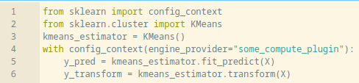
NumPExx
Exascale computing
Exploring a plugin system in scikit-learn:
> Preview of user workflow:
ExaDosT Kick-off meeting

Slide 24
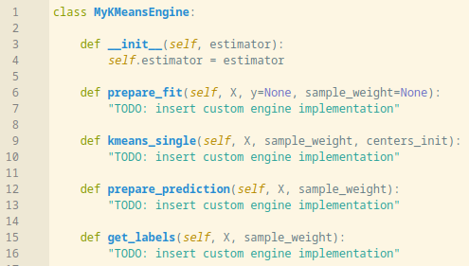
NumPExx
Exascale computing
Exploring a plugin system in scikit-learn:
> Example for plugin developers: register a custom engine class
> Test against native scikit-learn unit tests
ExaDosT Kick-off meeting

Slide 25
NumPExx
Exascale computing
Exploring a plugin system in scikit-learn:
Foundational issue https://github.com/scikit-learn/scikit-learn/issues/22438
Pull request https://github.com/scikit-learn/scikit-learn/pull/25535
Development branch https://github.com/scikit-learn/scikit-learn/tree/feature/engine-api
Example plugin for KMeans on intel GPUs
                https://github.com/soda-inria/sklearn-numba-dpex
ExaDosT Kick-off meeting

Slide 26

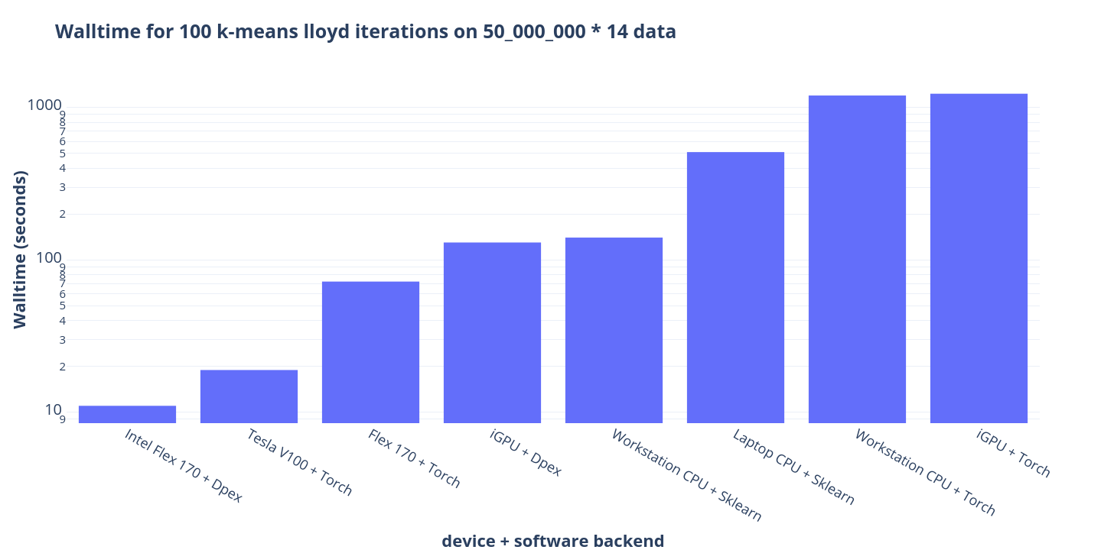

NumPExx
Exascale computing
A plugin for k-means with the oneAPI toolchain:
k-means is one order of magnitude faster on GPU, more significantly so when optimized with a low-level implementation
NB: cuml implementation of k-means for Nvidia GPUs could not be included in the figure because it could not scale to this amount of data memory-wise.
sklearn_numba_dpex
https://github.com/soda-inria/sklearn-numba-dpex
ExaDosT Kick-off meeting

Slide 27
NumPExx
Exascale computing
ROADMAP in ExaDost:
1 Engineer position to work on scikit-learn and joblib (MIND)
    Work on the lazy Array API
    Work on online computations with scikit-learn (partial_fit),
    Work on improving nested parallelism handeling.
1 PhD position with H. Hendrikx, (Thot)
    Improve the distributed algorithms in scikit-learn
ExaDosT Kick-off meeting

